Slide 1






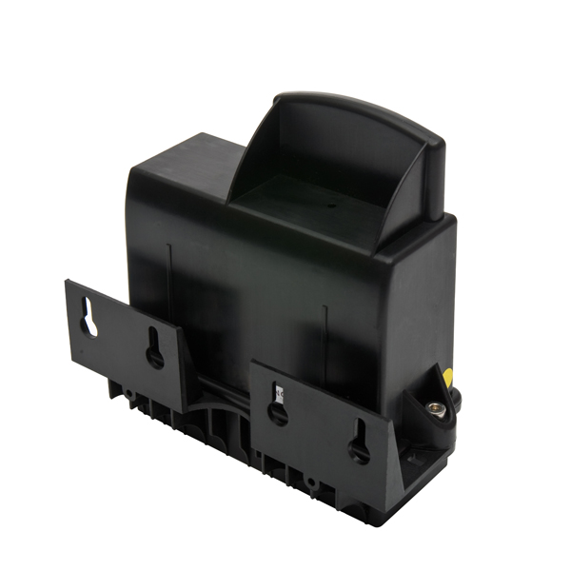
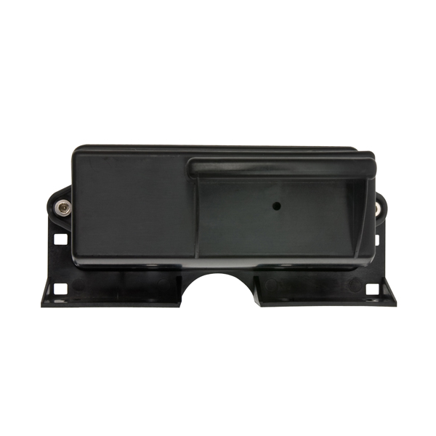
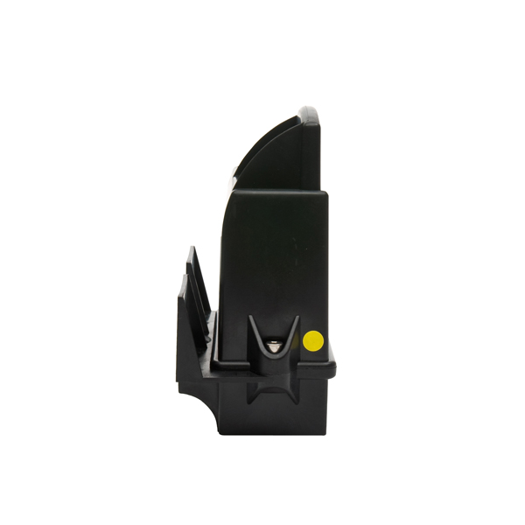
NB-IoT/CAT-M1 Logger Exi
With flexible sensor/meter connection options, the battery powered Intrinsically safe LPG logger is suitable for monitoring fuel tanks levels and flow rate.
Applications
LPG/Propane tank dial-gauge position measurement
  Rochester R3D/Twinsite Senior/Junior
Pressure sensor based vented tank liquid level monitoring
  Kerosene, Diesel, Gasoline
  Oils/Waste Oils
  Other hazardous/non hazardous
Utility meters/Flow meters
  Pulse output accumulation and reporting
Tanks
  Fixed or mobile
  Vented or pressurised
  Underground
  Tank size limited only by the capability of the sensor
  connected
Spot and continuous inventory measurement
Configurable reporting schedule and alarms
Benefits
Accurate, reliable tank level reporting to server monitoring application
Highly configurable server reporting interval from hourly to once per month
28 slot logger with configurable logging interval
Optimise delivery or collections
Programmable Alarms
  High level
  Low levels
  Rate of level change (fill or drain)
Reports local temperature, RSSI, and battery level
External antenna option for underground locations
Remote re-configurability
Plug and play installation
Mounting/attachment options – wall/pole
CE Conformance and ROHS Compliant
Tekelek, Shannon Free Zone, Shannon, Co. Clare, V14 XY18, Ireland
Tel : +353 (0)61 471511 | Fax: +353 (0)61 471685
E-mail: sales@tekelek.com | Web: www.tekelek.com
WEEE Reg. 00232
Patents granted
DS-5048-03

Slide 2
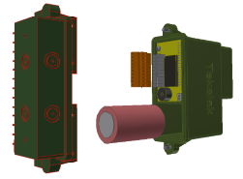
Characteristic | LPG logger 4G NB-IoT/CAT-M1
Dimensions Weight | 130mm x 125mm x 61mm / 5.1" x 4.9" x 2.4" (excluding cable gland/external connector) Weight 350g/0.77lbs
Housing Material | Moulded plastic, 2-part, material Glass Reinforced Polyamide, UV resistant.
Operating Temperature | -30°C to +55°C / -22°F to 131°F
Storage Temperature | 0°C to 30°C / 32°F to 86°F
Humidity | 0 – 100% RH
Environmental Protection | IP68
Communication | LTE CAT-M1 or NB-IoT With GPS.
Radio Frequency (Modem dependent) | BG96 | LTE FDD (Cat M1 & Cat NB1): B1/B2/B3/B4/B5/B8/B12/B13/B18/B19/B20/B26/B28 LTE TDD (Cat M1): B39 EGPRS: 850/900/1800/1900MHz
 | BG95 | LTE FDD (Cat M1): B1/B2/B3/B4/B5/B8/B12/B13/B18/B19/B20/B25/B26/B27/B28/B66/B85 LTE FDD (Cat NB2): B1/B2/B3/B4/B5/B8/B12/B13/B18/B19/B20/B25/B28/B66/B71/B85 EGPRS: 850/900/1800/1900MHz
GNSS (GPS) (Modem dependent) | BG96 | GPS, GLONASS, BeiDou/Compass, Galileo, QZSS
 | BG95 | GPS, GLONASS, BeiDou, Galileo, QZSS
Pressure sensor | Pressure sensors from various manufacturers operating from 5V supply may be connected. 0V to 5V ratiometric with programmable scaling
Dial-gauges | 5V Rochester Senior/Junior Twinsite/R3D (Rochester DS-1318.pdf compatible as standard)
Accuracy/resolution | 10-bit A/D resolution, Accuracy is dependent on the gauge used
2 x Pulse counter inputs option | 2 x volt free switch inputs with pull up resistors to 5V
Loop current measurement option | 120 ohm internal load. 4-20mA measurement possible with external energising source.
Serial data | Serial data support is possible – Contact factory
Power requirements | Battery pack with standard cell sizes connected with a 2 wire harness included
Battery technology | 3.6V Lithium Thionyl Chloride Exi “Bobbin type” construction
Battery life | Up to 10 years*
Safety | ATEX Zone II 1 G-Ex ia IIB T4 Ga [-30 < Ta < +55°C / -22°F to 131°F ] and IECeX/Hazloc equivalents (Excludes D Cell)
Conformance | CE, IECeX, RoHs, RED
Manual Activation | Magnetically activated reed switch / Audible buzzer / Internal LED
Installation | Plug and play installation. Shipped pre-configured with customer supplied SIM card and Rochester gauge installed
* Based on 1 communication per day and good network coverage
Configuration/Specification Options
External connection | IP68 Cable gland (side or bottom) / IP68 bulkhead connector
Server radio communications | PTCRB (AT&T) & Verizon approvals. FCC, RED, CE approvals.
Antenna | Internal with option for antenna coupler with SMA connector to allow connection of an external GSM antenna
Battery size | Several options up to a D cell size are available
Data Communications | Tekelek proprietary protocol
Fixing/Mounting | Screw mounts (4), tie wrap, & pole mount features are standard.
Tekelek, Shannon Free Zone, Shannon, Co. Clare, V14 XY18, Ireland
Tel : +353 (0)61 471511 | Fax: +353 (0)61 471685
E-mail: sales@tekelek.com | Web: www.tekelek.com
WEEE Reg. 00232
Patents granted

