Slide 1





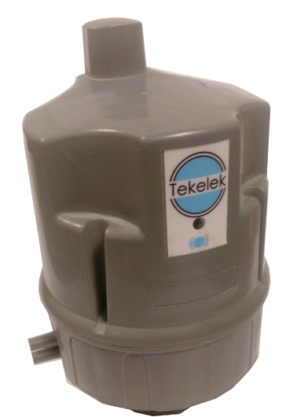
Ultrasonic 4G NB-IoT/CAT-M1
Our Ultrasonic 4G NB-IoT/CAT-M1 is a flexible and configurable battery operated liquid level sensor with an integrated Cellular modem supporting GSM (2G), LTE-CAT M1 & NB-IoT networks and GPS.
Applications
Liquid level monitoring
  Fuel – Oil, Kerosene, Diesel
  Lubricants
  Additives
  DEF / AdBlue
  Coolants
  Water
  Waste Oil
  Wastewater
  Chemicals - *This product may not be suitable for monitoring of certain corrosive and hazardous chemicals. List of product compatible chemicals to be verified with a Tekelek representative.
Fixed or portable tanks
Ensure continued supply
Optimise delivery or collections
Spot and continuous inventory measurement
Benefits
Accurate, reliable tank level monitoring
Programmable data reporting interval
Remote configurability
Easy to install
Minimum 1 year warranty
CE Conformance, ROHS and PTCRB Compliant
International Approvals
Programmable alarms
  Full alert
  Empty alert
  Spill alert (bunded tanks)
  Fill alert
  Low and High levels
  24/7 Monitoring
WEEE Reg. 00232
Patents granted
Tekelek, Shannon Industrial Estate, Shannon, Co. Clare, Ireland
Tel : +353 (0)61 471511
E-mail: sales@tekelek.com | Web: www.tekelek.com
DS-5049-08

Slide 2
Specification
Characteristic | Transmitter
Dimensions | 101mm (W) x 93mm (L) x 150mm (H) ±1mm / 4”(W) x 3.66”(L) x 5.9”(H) ±0.04”
Weight | 530g/1.17lbs including 4 x C size batteries - 290g/0.6lbs without batteries
Housing Material | UV Stabilized Polypropylene (compatible with Oil)
Operating Temperature | -20°C to 50°C / -4°F to 122°C (Note 1)
Storage Temperature | -30°C to 60°C / -22°F to 140°F (Note 1)
Altitude Range | <2Km/1.25miles above sea level
Environmental Protection | IP67 – Outdoors
Radio Frequency (Modem dependent) | BG96 | LTE FDD (Cat M1 & Cat NB1): B1/B2/B3/B4/B5/B8/B12/B13/B18/B19/B20/B26/B28 LTE TDD (Cat M1): B39 EGPRS: 850/900/1800/1900MHz
 | BG95 | LTE FDD (Cat M1): B1/B2/B3/B4/B5/B8/B12/B13/B18/B19/B20/B25/B26/B27/B28/B66/B85 LTE FDD (Cat NB2): B1/B2/B3/B4/B5/B8/B12/B13/B18/B19/B20/B25/B28/B66/B71/B85 EGPRS: 850/900/1800/1900MHz
GNSS (GPS) (Modem dependent) | BG96 | GPS, GLONASS, BeiDou/Compass, Galileo, QZSS
 | BG95 | GPS, GLONASS, BeiDou, Galileo, QZSS
Gauge Type | Ultrasonic
Ultrasonic Range | >12cm to <4m / >4.7” to 157” at 20°C(-4°F) (Note 2)
Ultrasonic Signal Diversion | See polar plot (Note3)
Ultrasonic Resolution | ±1cm / ±0.04”
Accuracy | Typically ±2cm from 12cm to 3m / ±0.78” from 4.7” to 118”
Software Features | Includes Tekelek’s advanced sonics with quality parameters
Material compatibility | (Note 4)
Power requirements | 4 of Type C LR14 Alkaline 1.5V (fitted)
Battery life | 5 Years (Note 5)
Tank mounting options | Fit directly into 1 ¼”, 1 ½” or 2” BSP existing tank connection
Accessories
SIM Card | Options available
Conformity
EMC directive 2014/30/EU | The Electromagnetic Compatibility (EMC) Directive ensures that electrical and electronic equipment does not generate, or is not affected by, electromagnetic disturbance.
LVD directive 2014/35/EU | The Low Voltage Directive (LVD) ensures that electrical equipment within certain voltage limits provides a high level of protection for European citizens, and benefits fully from the Single Market.
RED directive 2014/53/EU | The Radio Equipment Directive ensures a Single Market for radio equipment by setting essential requirements for safety and health, electromagnetic compatibility, and the efficient use of the radio spectrum.
RoHs directive 2011/65/EU | This Directive lays down rules on the restriction of the use of hazardous substances in electrical and electronic equipment (EEE) with a view to contributing to the protection of human health and the environment, including the environmentally sound recovery and disposal of waste EEE.
CE compliance | Yes
Note 1: Storage and operation above 20°C / 68 °F may reduce battery life. Minimum distance measured is de-rated to 20cm with temperatures <0°C / 32°F
Note 2: Based on a measurement to a flat liquid target of size 30cm² / 4.7”²
Note 3: The maximum spatial diversion of the ultrasonic signal is shown on a polar plot included with this datasheet.
Note 4: Suitable for use in tanks for the storage of water diesel fuel, kerosene, gas oil types A2,C1,C2 and D as defined by BS2869.
Note 5: Based on one data drop per day in standard configuration at a location with adequate CAT-M1/NB-IoT coverage.
WEEE Reg. 00232
Patents granted
Tekelek, Shannon Industrial Estate, Shannon, Co. Clare, Ireland
Tel : +353 (0)61 471511
E-mail: sales@tekelek.com | Web: www.tekelek.com

Slide 3
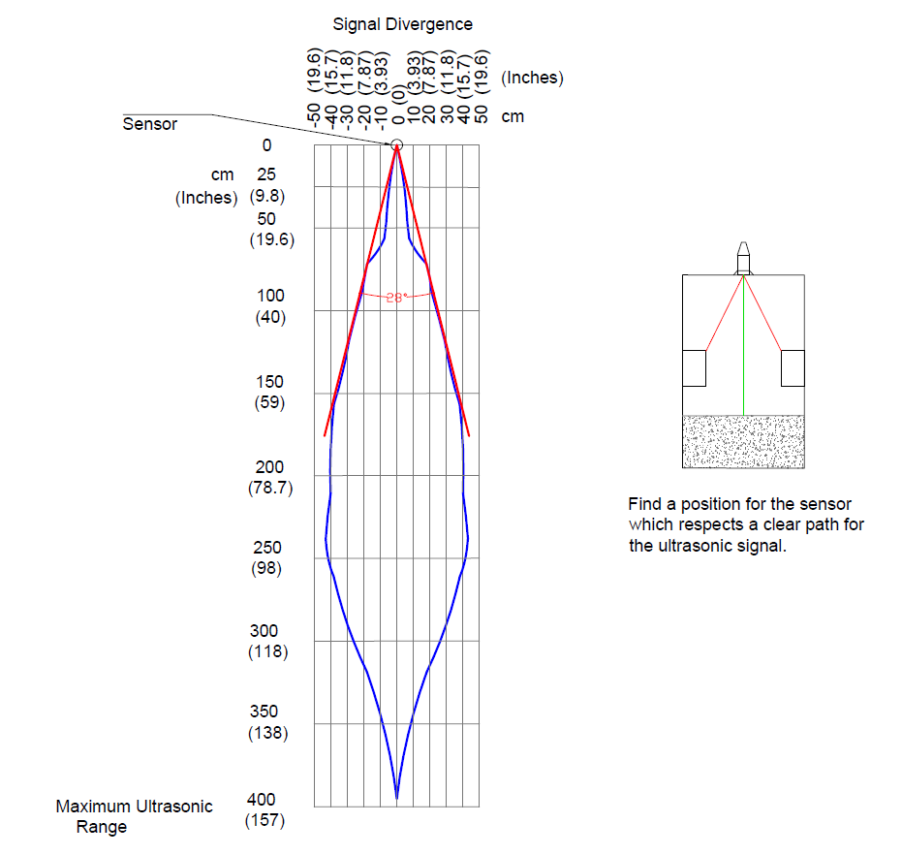
Specification
WEEE Reg. 00232
Patents granted
Tekelek, Shannon Industrial Estate, Shannon, Co. Clare, Ireland
Tel : +353 (0)61 471511
E-mail: sales@tekelek.com | Web: www.tekelek.com

